Slide 1
Game’s pipeline integration with Babylon.js
Introduction to WebGL 3D with HTML5 and Babylon.js

Slide 2
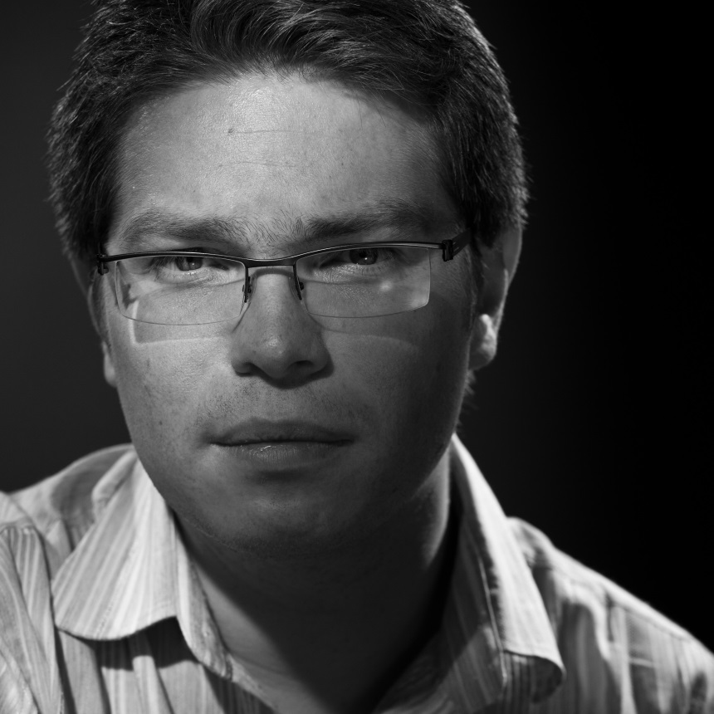

WHO ARE WE?
Geeks, web developers, 3D addicts
DAVID ROUSSET
DAVID CATUHE
TECHNICAL EVANGELIST
PRINCIPAL PROGRAM MANAGER
Twitter: @davrous
http://blogs.msdn.com/davrous
Twitter: @deltakosh
http://blogs.msdn.com/eternalcoding
Do not try to tune your speakers, the weird sound is due to French accent…

Slide 3

Setting Expectations
Target Audience
JavaScript developer
Game developer
Suggested Prerequisites/Supporting Material
Visual Studio 2013 Express for Web

Slide 4
Join the MVA Community!
Microsoft Virtual Academy
Free online learning tailored for IT Pros and Developers
Over 2M registered users
Up-to-date, relevant training on variety of Microsoft products
“Earn while you learn!”
Get 50 MVA Points for this event!
Visit http://aka.ms/MVA-Voucher
Enter this code: WebGL3D1 (expires 21 Nov 14)

Slide 5


Course topics
Introduction to WebGL 3D with HTML5 and Babylon.js
Day One
01 | 3D on the Web: Understanding the Basics | 02 | WebGL Basics
03 | Using Babylon.js for Beginners | 04 | Understanding materials and inputs
Day Two
01 | Game Pipeline Integration with Babylon.js | 02 | Loading Assets
03 | Babylon.js: Advanced Features | 04 | Special Effects

Slide 6
AGENDA
1
Working with Blender 3D
2
Working with 3ds Max
3

Slide 7
Section One
Working with Blender 3D
And the Sandbox

Slide 8







Creation Pipeline
.babylon
.FBX
converter
.OBJ
.FBX
.OBJ

Slide 9
Blender to Babylon.js exporter features support
Cameras
Name
Position
Target
Fov
Clip start
Clip end
Check collisions
Gravity
Ellipsoid
Lights
Type (Point, directional (Sun), Spot, Hemispheric)
Name
Position
Direction
Spot size
Spot blend
Energy
Diffuse color
Specular color
Materials & Multi-mat
Name
Ambient color
Diffuse color
Specular color
Specular hardness
Emissive color
Alpha
Backface culling
Diffuse texture
Ambient texture
Opacity texture
Reflection texture
Emissive texture
Bump texture
Textures
Name
Associated file
Level
Use alpha
uOffset / voffset
uScale / uScale
uAng / vAng / Wang
WrapU / WrapV
Coordinates index
Meshes
Name
Geometry (Positions & normals)
Position
Rotation
Scaling
Texture coordinates (2 channels)
Vertex colors
Visibility
Check collisions
Billboard
Receive and cast shadows
Bones (armatures) and bones' animations
◦Animations

Slide 10
USING BLENDER EXPORTER & THE SANDBOX
DEMO

Slide 11
Section Two
Working with 3ds Max

Slide 12
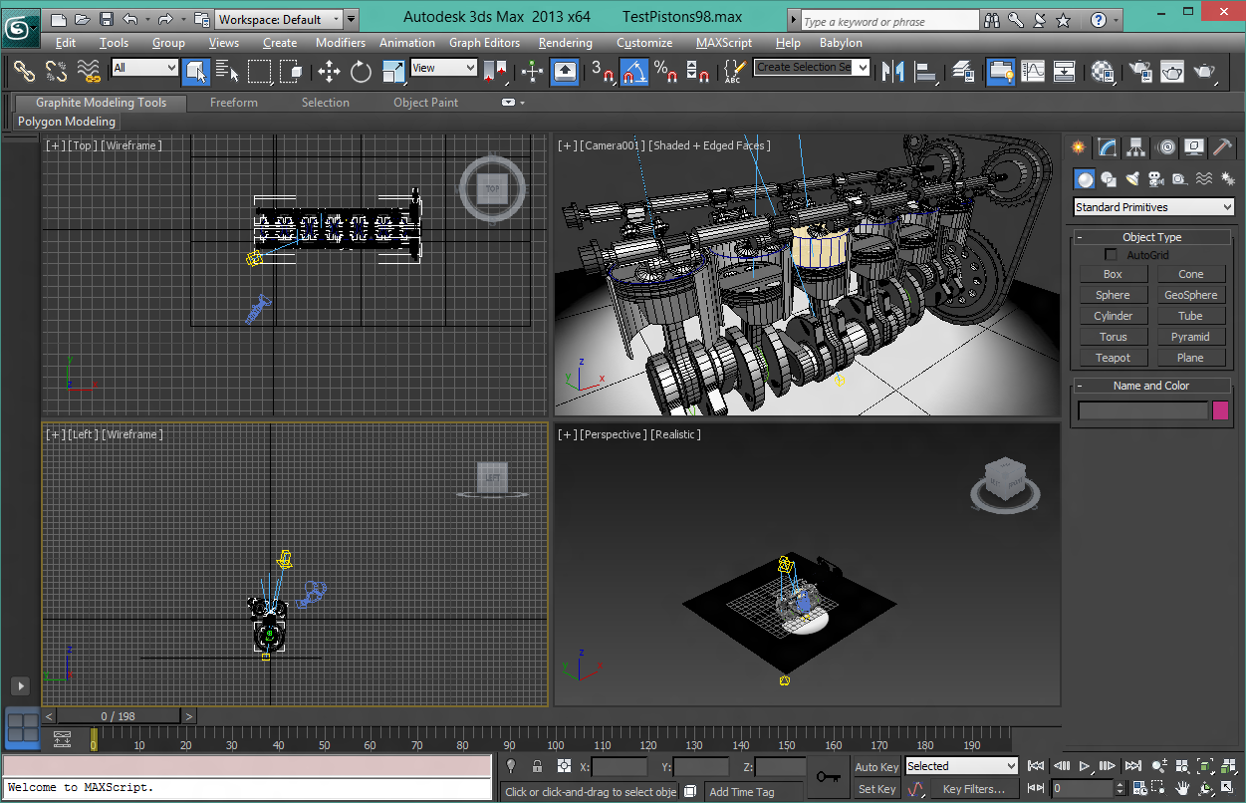
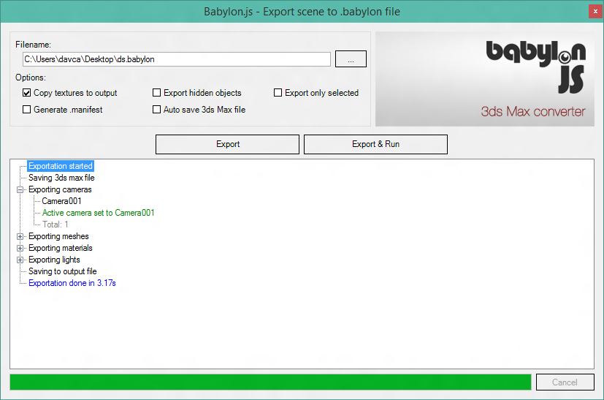
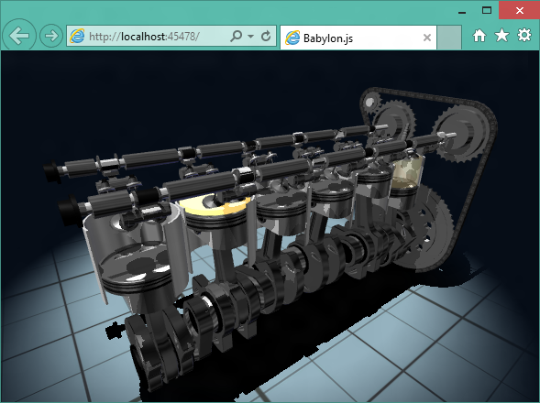
Fully integrated pipeline exportation
One click exportation
Integrated web server
Export:
Cameras, lights, meshes
Animations and regular materials

Slide 13
USING 3DS MAX EXPORTER
DEMO

